Slide 1


模拟电子技术基础
Analog Device
9 Signal Generation - Non sine-wave
信号的产生 – 非正弦信号
陈晓龙 Chen, Xiaolong
电子与电气工程系 E³

Slide 2
9.5 Voltage comparator 电压比较器
Identify or compare the amplitude of input signals 用来鉴定或比较输入信号的幅值
Fundamental component of non-Sine-wave generator 非正弦发生器的基本电路

Slide 3
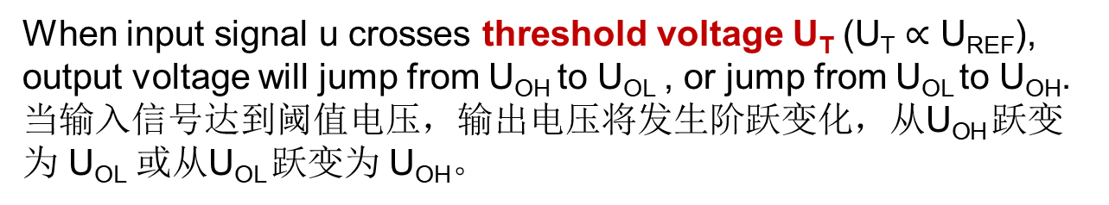
Voltage comparator 电压比较器
Reference level/Voltage reference U_{REF} 参考电平/基准电压
Input terminal
Input voltage U_{I}被比较的输入电压
Output terminal：
Output signal only has too values: high level U_{OH} or low level U_{OL} 输出信号只有高电平和低电平两个电压值

Slide 4









Voltage comparator 电压比较器
Input signal
Voltage comparator
Output signal
Reference voltage
High level
Low level
Threshold voltage

Slide 5















Real and ideal operational amplifier
Real operational amplifier
Ideal operational amplifier

Slide 6

Ideal operational amplifier
In this chapter, we will use the saturation property of operational amplifier (运放的饱和特性) to realize voltage comparator and non-sine-wave generator.

Slide 7


















(1) Single-limit voltage comparator 单限比较器
(a) Threshold voltage U_{T}=0

Slide 8





Real
Ideal

Slide 9










Protect input stage

Slide 10













Slide 11
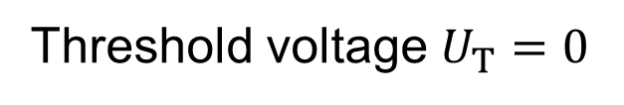
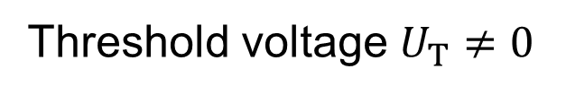








?

Slide 12













Slide 13











(b) Threshold voltage U_{T}≠0
Question 1: Threshold voltage U_{T}?

Slide 14












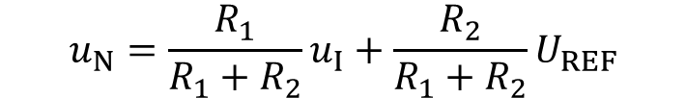



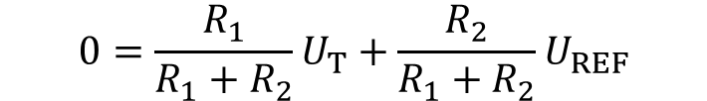



(b) Threshold voltage U_{T}≠0
Question 1: U_{T}?

Slide 15
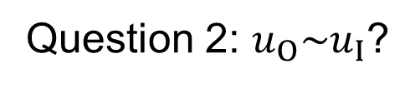

















Slide 16

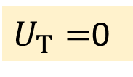






Signal waveform conversion 波形变换

Slide 17
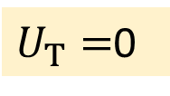

Signal waveform conversion 波形变换

Slide 18
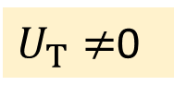


Signal waveform conversion 波形变换

Slide 19





Single-limit voltage comparator
Merits:
Simple
High sensitivity 灵敏度高
Drawbacks:
Low anti-interference capacity 抗干扰能力弱

Slide 20




Low anti-interference capacity 抗干扰能力弱

Slide 21
Low anti-interference capacity 抗干扰能力弱
False signal

Slide 22
How to improve the anti-interference capacity? 如何提高抗干扰能力弱

Slide 23









(2) Hysteresis comparator 滞回比较器
(a) Inverted input 反相输入
Question1: Positive or negative feedback?
Question2: Linear region or saturation region?

Slide 24







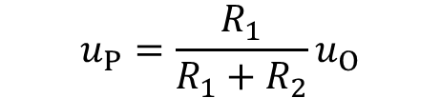




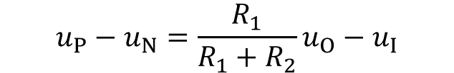


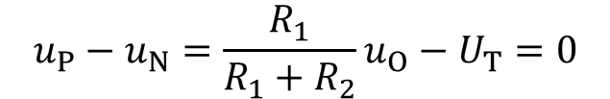



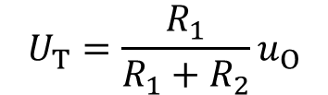
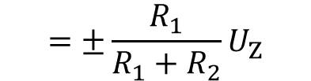

Working principle

Slide 25














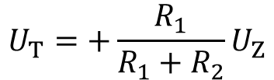








Working principle

Slide 26














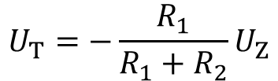








Working principle

Slide 27















Indistinguishable region
不能分辨区

Slide 28



High anti-interference capacity 抗干扰能力强

Slide 29













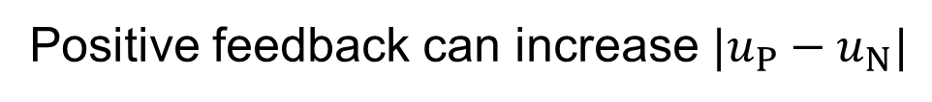

Slide 30


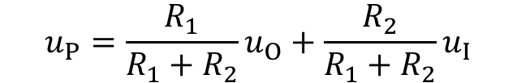




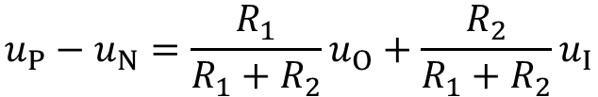





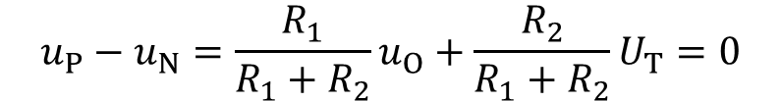
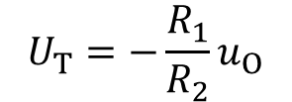
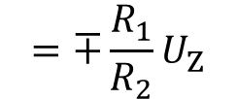
(b) Non-inverted input 同相输入
Working principle

Slide 31










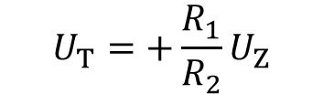
Working principle

Slide 32



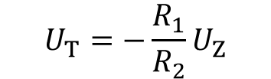


Working principle

Slide 33






























Inverted input
Non-inverted input
Anticlockwise
Clockwise

Slide 34



















(c) Hysteresis comparator with reference voltage

Slide 35






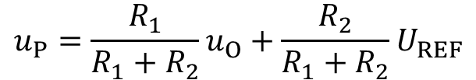


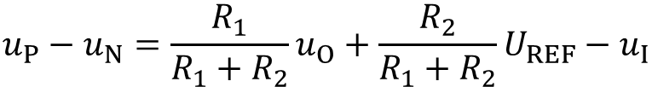






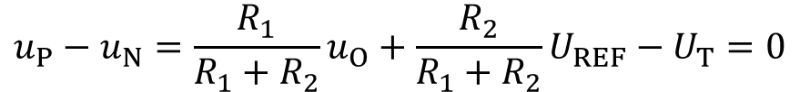




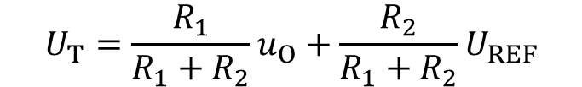
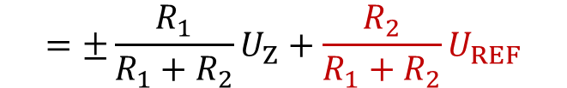


Slide 36


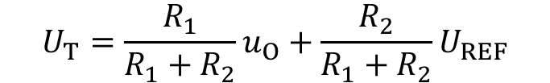





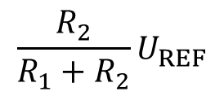

Slide 37











Slide 38







(3) Window comparator 窗口比较器
Can be applied in industrial control systems: measuring the range of temperature, pressure or liquid level.用于工业控制系统，测量温度、压力、液面等的范围。

Slide 39















(3) Window comparator 窗口比较器

Slide 40

























Working principle
D1
D2
D1 is on
D2 is off
D1 is off
D2 is on

Slide 41




D1
Working principle
D2
D1 is off
D2 is off

Slide 42
9.6 Non-sine-wave generator
Rectangular wave
Triangular wave
Sawtooth wave
Peaked wave

Slide 43
(1) Rectangular wave generator
(a) First method
Single-limit voltage comparator / Hysteresis comparator
Sine-wave generator
Rectangular wave

Slide 44

















(b) Second method: use one operational amplifier
Hysteresis comparator

Slide 45






















Working principle
Fast
Slow

Slide 46















Working principle
Fast
Slow

Slide 47



















Waveform of output signal u_{O} 输出波形

Slide 48


























Oscillation period/frequency

Slide 49





Oscillation period/frequency

Slide 50























Question: what’s the oscillation period of right circuit?

Slide 51
























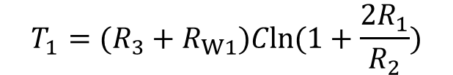
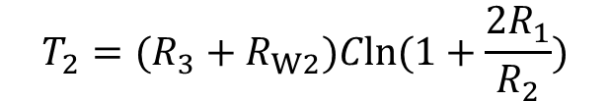

Question: what’s the oscillation period of right circuit?

Slide 52
(2) Triangular wave generator
积分运算放大器
Rectangular-wave generator
Integration operational amplifier
Triangular wave

Slide 53


















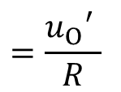

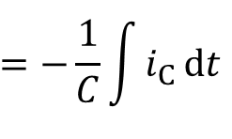
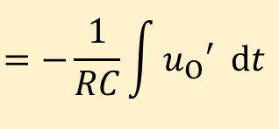

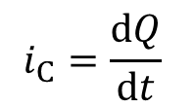
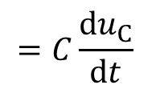

Slide 54




0
0

Slide 55



















Improved triangular wave generator

Slide 56












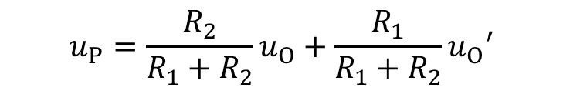

Slide 57
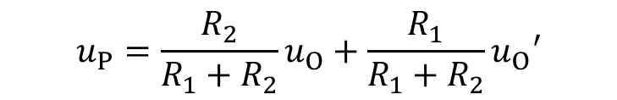
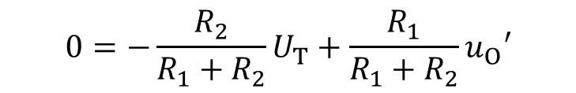


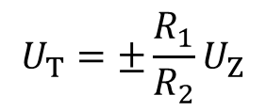

Slide 58










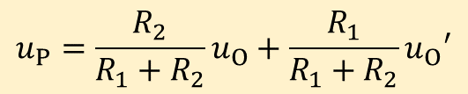

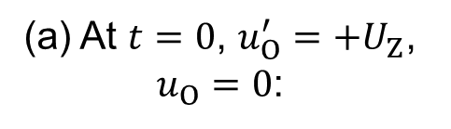


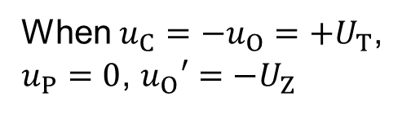
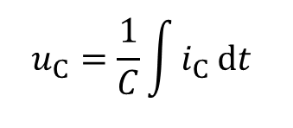
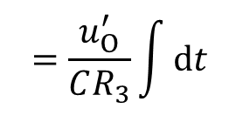
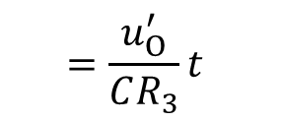
Fast
Slow

Slide 59



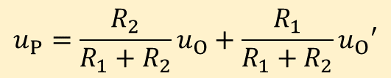

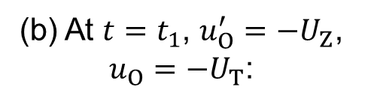





Fast
Slow

Slide 60












Slide 61









Question: what’s the oscillation period of right circuit?

Slide 62
(3) Sawtooth wave generator
Triangular wave
Sawtooth wave
0
0

Slide 63














Slide 64


















Period:

Slide 65





0

Slide 66
Homework：refer to blackboard

